Slide 1
Software Analysis and Design
Software Development Life Cycle
Department of Software Engineering,
FAST-NUCES, CFD Campus

Slide 2
Lecture Objectives
Software development core activities
Software development framework
Software development life cycle
Software development process models

Slide 3
Lecture Material
Ian Sommerville (Chapter 2)

Slide 4
Basic Terminologies
Process
  Set of activities, actions, tasks required to obtained the desired output, also called process framework.
Model
  An abstract representation of a software process.
Product
  An output of a process activity, also called an artifacts.
Stakeholders
  A stakeholder is anyone who has a stake in the successful outcome of the project.
Software System
  A piece of code in the executable form
Project
  A piece of code in the development phase

Slide 5
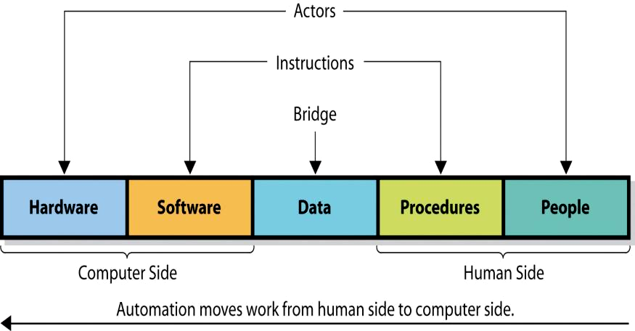
Software Systems Components

Slide 6
Fundamental Software Engineering Activity
The software fundamental Activities are
Software Specification:
The functionality of the software and constraints on its operation must be defined
Examples:
Online Banking System should allow users to check their account balance and transfer funds.
E-commerce Website must support secure payment processing and order tracking.
Software Development:
Examples:
Online Banking System: Developers implement a secure login system and a funds transfer module.
E-commerce Website: Engineers develop the payment gateway integration and order tracking functionality. software to meet the specification must be produced.

Slide 7
Fundamental Software Engineering Activity
Software Validation:
The software must be validated to ensure that it does what the customer wants
Examples:
Online Banking System: Testing ensures that users can successfully transfer funds without errors.
E-commerce Website: Validation checks if payment transactions are processed securely and correctly.
Software Evolution:
The software must be evolve to meet changing customer needs
Examples:
Online Banking System: Adding support for biometric authentication for enhanced security.
E-commerce Website: Introducing AI-based product recommendations to improve user experience.

Slide 8
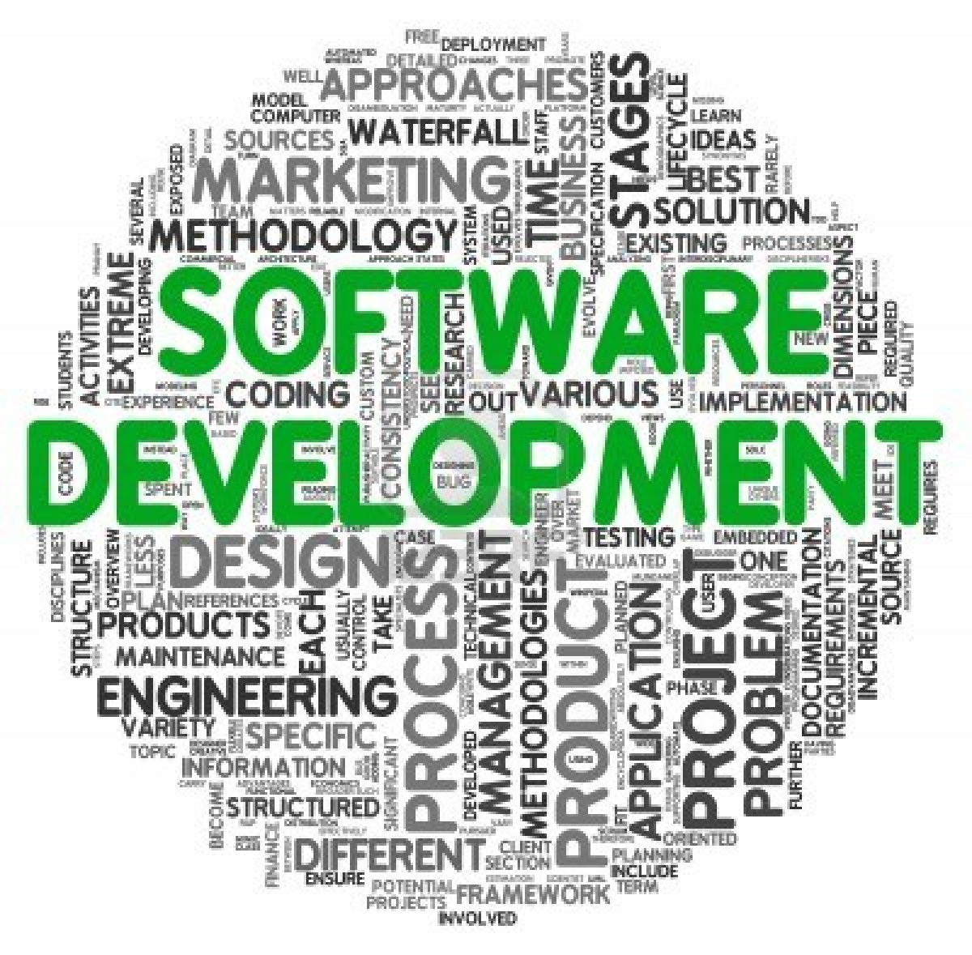
Software Development Core Activities
Understand the need (business need)
Capture the vision
Define a solution
Communicate the vision and solution
Build the solution
Confirm that the solution meets the need
Launch the solution system

Slide 9
Software Process Framework
Specification
Modelling
Development
Validation
Deployment
Evolution
Software process framework might be called as software development life cycle.

Slide 10
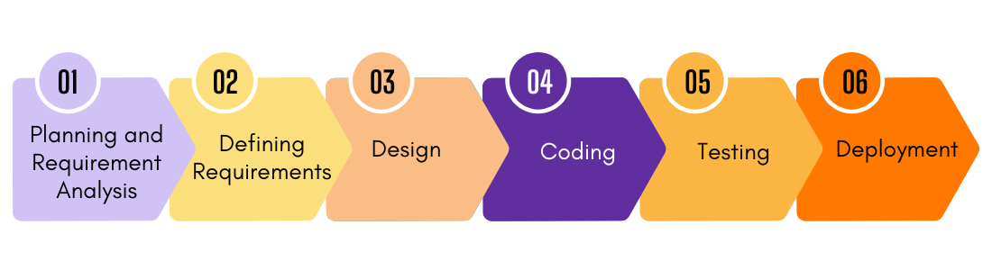
Software Development Life Cycle
Minor Focus
Major Focus
Minor Focus

Slide 11
Software Process Framework
Umbrella Activities
  Software project tracking and control
  Risk management
  Software quality assurance
  Technical reviews
  Measurement
  Software configuration management
  Reusability management
  Work product preparation and production

Slide 12
Software Development Principles
The reason it all exists
Keep it simple, stupid
Maintain the vision
What you produce, others will consume
Be open to the future
Plan ahead for reuse
Think
Notes:
https://wiki.c2.com/?SevenPrinciplesOfSoftwareDevelopment

Slide 13
Software Development Process Models
Plan driven
  Waterfall
  V Model
  Evolutionary Models
    Incremental
    Iterative
    Prototyping
    Spiral
    Reuse based / Component based
    Rational Unified Process (RUP)
Agile
  Scrum
  XP

Slide 14
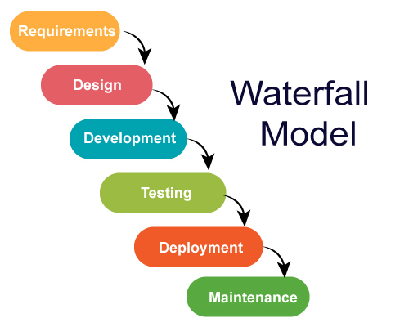
Software Development Process Models -- Waterfall

Slide 15
Waterfall Model
Pros:
Simple and Easy to Manage
Clear Documentation
Ideal for Small, Well-Defined Projects
Early Detection of Defects
Cons:
Rigid & Inflexible
Late Testing
High Risk
Not Suitable for Complex & Evolving Projects.

Slide 16
Waterfall Model
Projects with Well-Defined & Stable Requirements – Example: Payroll Systems, Banking Applications.
Short & Simple Projects – Example: Internal tools, Government Software.
Regulated Environments Requiring Strict Documentation – Example: Aerospace, Healthcare Software..

Slide 17
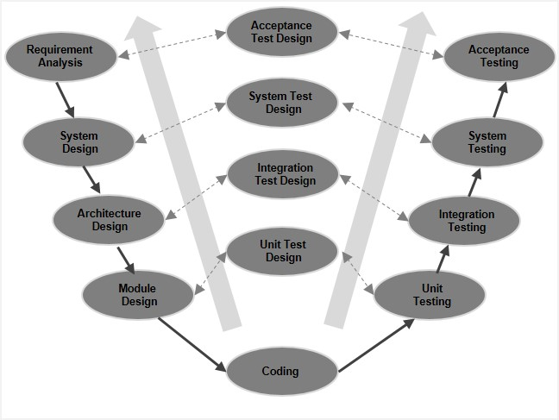
V- Model
Software Engineering

Slide 18
V Model
Pros:
Structured Approach
Early testing
High Quality
Better taceability
Cons:
Rigid & Inflexible
Expansive fixes
Not Suitable for Iterative Development

Slide 19
V Model
For small to medium projects with stable requirements (e.g., banking software, medical devices).
Where quality and testing are crucial (e.g., aerospace, safety-critical systems).
Not ideal for projects with evolving requirements

Slide 20
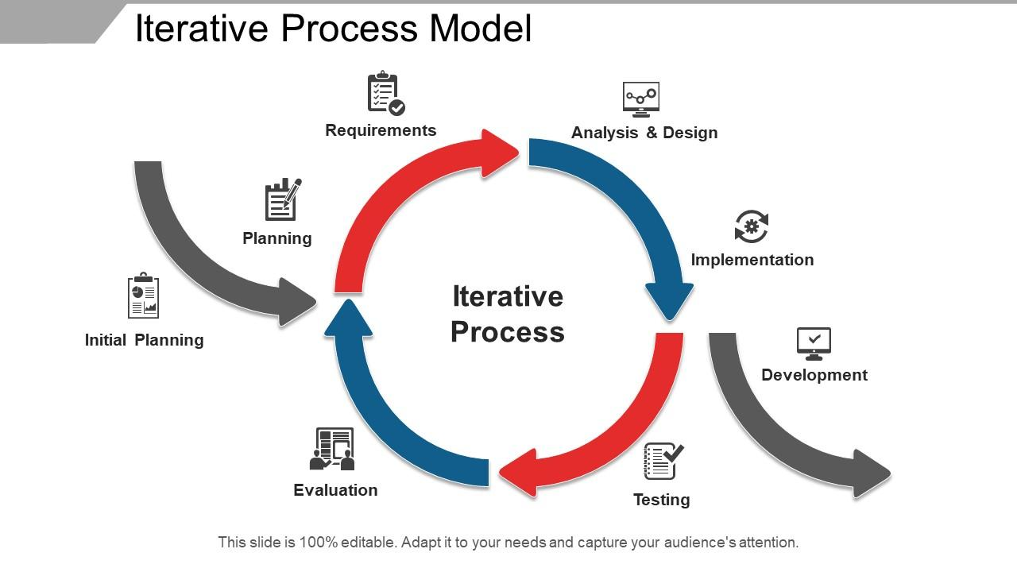
Software Development Process Models -- Iterative

Slide 21
Software Development Process Models -- Iterative
Project is broken down into smaller cycles or iterations
Each iteration goes through the phases of planning, design, implementation, testing, and evaluation.
Develop a system incrementally, refining and improving it based on feedback from previous iterations
Key Features are
Incremental Development
Continuous Refinement
Risk Management
Flexibility
Parallel Development

Slide 22
Software Development Process Models -- Iterative
Advantages
Early detection and resolution of defects.
Easier to accommodate requirement changes.
Provides a working version of the software early in the process.
Disadvantages
Requires more resources and planning.
Not suitable for projects with very well-defined and fixed requirements.

Slide 23
Software Development Process Models -- Incremental
The system is developed and delivered in small, functional increments. Each increment adds new features until the full system is complete.
Requirements are divided into multiple independent modules.
Each module is fully designed, developed, and tested before moving to the next one.
Every increment is a functional part of the final product.
Example:
A messaging app is first developed with basic texting.
The next increment adds voice calls.
Another increment adds video calls, and so on.

Slide 24
Software Development Process Models -- Incremental
Advantages
Prioritization of essential features.
Early software delivery with usable functions.
Easier bug detection within each module.
Disadvantages
Integrating new increments with older ones can be complex.
Initial versions may lack key functionalities.

Slide 25
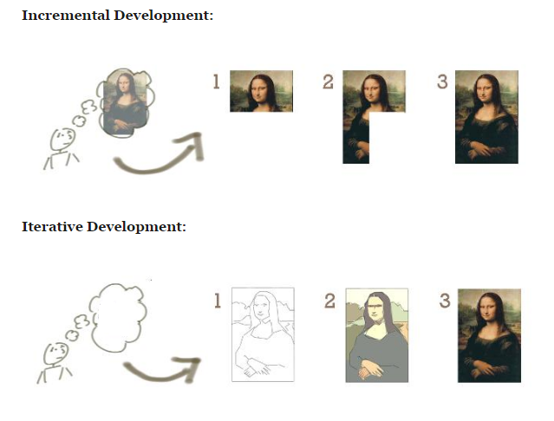
Software Engineering

Slide 26
Prototypes
Gather Use Requirements
Refine user requirements
Begin next increment
Develop throwaway horizontal prototype
Construct evolutionary prototype
Construct vertical prototype
Design User Interface
Verify and deliver
increments
Design Software architecture
Construct and verify product
Deliver product
Several possible ways to incorporate prototyping into the software development process

Slide 27
Prototypes
working prototype (an early version of the system) is built, tested, and refined based on user feedback before developing the final system.
Useful when requirements are unclear or evolving.
Advantages
Better Requirement Understanding:Helps users visualize the system early, reducing misunderstandings.
User Involvement: Users actively participate in development, ensuring the final product meets their needs.
Early Error Detection: Issues and missing features can be identified and fixed before full development.
Reduced Development Risks: Helps avoid costly changes in later stages of development.
Faster Feedback Loop: Users get a tangible model to test rather than just written specifications.

Slide 28
Prototypes
Disadvantages:
Scope creep
Higher Cost
Poor Performance consideration
Not Suitable for large scale Systems
Best for:
Unclear or evolving requirements (e.g., startups, research projects).
User-driven applications (e.g., UI/UX-heavy applications, web apps).
New or innovative systems where feasibility must be tested.
High-risk projects requiring early validation
Examples: Mobile App, E-commerce, AI/ML Projects

Slide 29
Spiral Model (Diagram)
Planning
Communication
Start
Modeling
Start
Deployment
Construction

Slide 30
Spiral Model (Diagram)
risk-driven software development process that combines elements of the Waterfall Model and Iterative Model.
Focuses on continuous risk assessment and allows for multiple iterations (spirals) of development.
The system evolve over several cycles
Advantages:
Effective Risk Management Risk is analyzed early and continuously, reducing project failures.
Flexibility in Requirements
Customer Involvement
Incremental Releases
Strong Documentation

Slide 31
Spiral Model (Diagram)
Disadvantages:
High Cost
Time-Consuming
Requires Expertise
Difficult to Manage
Not Suitable for Small Projects
Best for:
Large, high-risk projects (e.g., defense, aerospace, banking software).
Projects with evolving or unclear requirements.
Mission-critical systems where failures have serious consequences.
Examples: Large enterprise applications, Military and Aerospace application and Healthcare and medical system

Slide 32
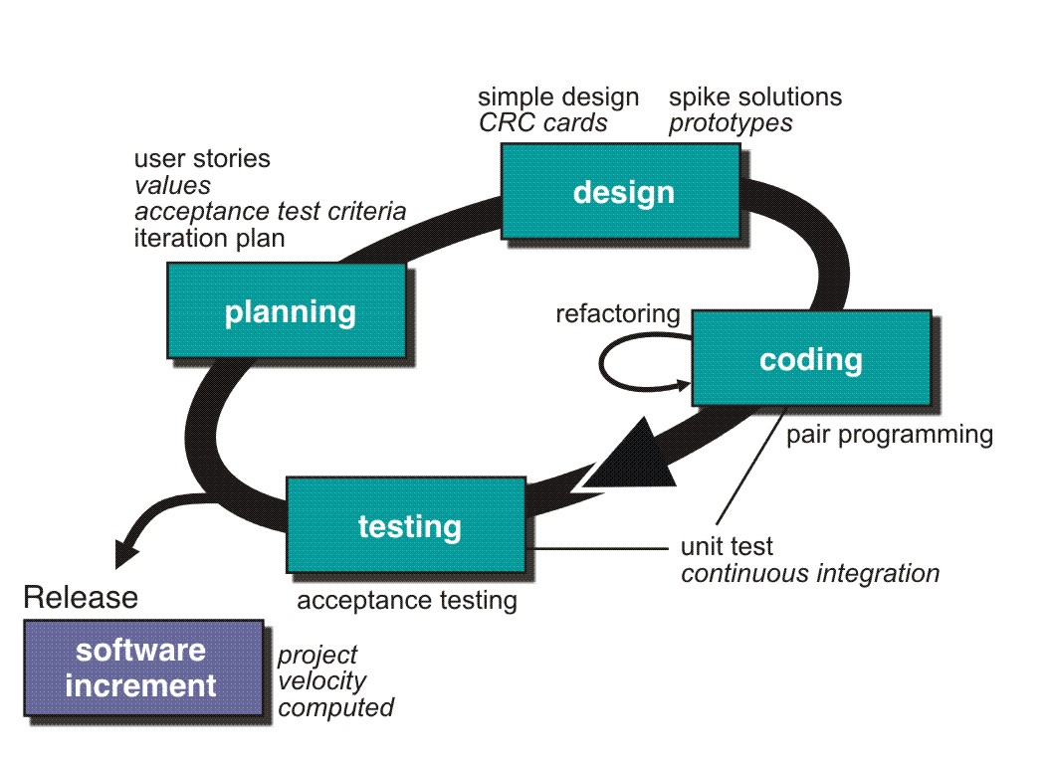
Extreme Programming (XP)
http://www.extremeprogramming.org/rules/spike.html

Slide 33
Extreme Programming (XP)
An Agile software development methodology
Emphasizes frequent releases, continuous feedback, and high adaptability to changing requirements.
Encourages close collaboration between developers, customers, and stakeholders
Advantages:
Rapid Development & Frequent Releases
High-Quality Code
Pair Programming ensures fewer bugs and better code quality.
Test-Driven Development (TDD) helps in early bug detection.
Flexibility to Changing Requirements
Continuous Feedback & Improvement
Reduces Overwork (Sustainable Pace)

Slide 34
Extreme Programming (XP)
Projects with high customer involvement.
Disadvantages:
Requires Continuous Customer Involvement
Frequent feedback from customers is essential, which can be difficult in some cases.
High Dependency on Skilled Developers
XP relies heavily on experienced and disciplined developers.
Difficult to Scale for Large Teams
Frequent Changes Can Cause Instability
Extensive Testing Increases Effort
Best for:
Startups & dynamic environments with evolving requirements.
Project with high customer involvement
Teams focused on rapid software delivery & quality improvement.

Slide 35
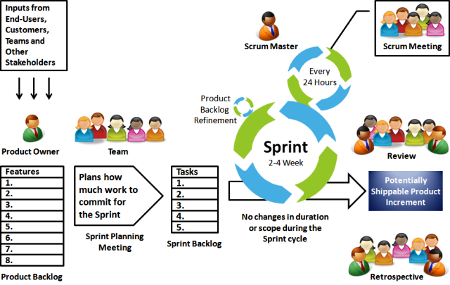
Scrum

Slide 36
Scrum
focuses on iterative progress, collaboration, and flexibility.
Divides development into sprints (short, time-boxed iterations, typically 2-4 weeks), allowing teams to adapt to changing requirements efficiently
Advantages
Adaptability to Changes
Faster Delivery
Enhanced Collaboration
High Product Quality
Better Risk Management

Slide 37
Scrum
Projects with high customer involvement.
Disadvantages:
Requires Experience Team.
Scope Creeps
Time consuming meetings
Hard to Scale large teams
Lack of Documentation
Best for:
Startups & dynamic environments with evolving requirements.
Project requiring quick delivery
Cross functional teams.

